Slide 1
Multi-Task Learning for Straggler Avoiding Predictive Job Scheduling
胡嘉祐

Slide 2
Outline
Straggler
Motivation
Reactive and proactive method
Wrangler

Slide 3
What is Straggler?
Jobs break into task
Task parallel execute
8 times slower than the median task

Slide 4
Motivation
The growing popularity of Internet-based applications
Straggler delay very much
Many reasons cause straggler

Slide 5
reactive
Two steps :
(1) wait-and-speculate
(2) replicate
No benefit
proactive
Directly duplicate without speculate
resource overhead

Slide 6
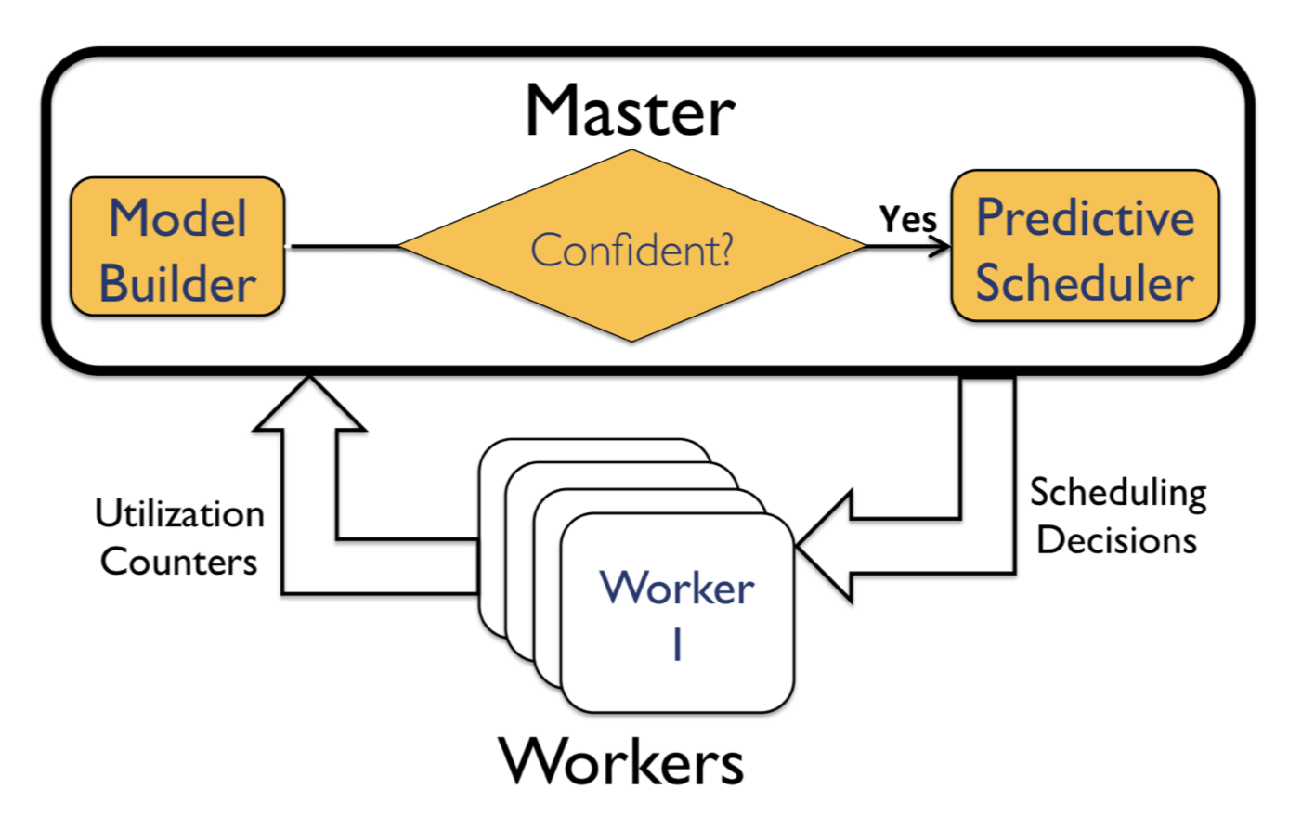
Wrangler
predict nodes that might create stragglers and reject it
Proactive
avoid replication

Slide 7
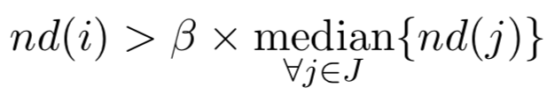
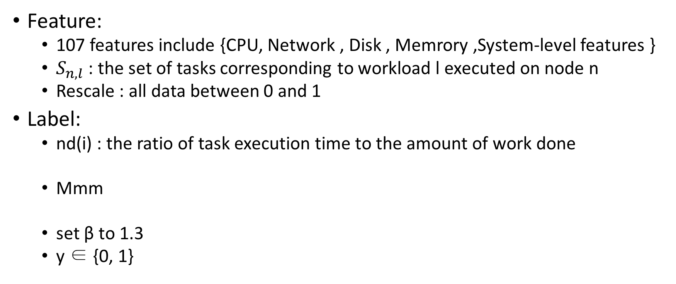
Wrangler (feature and label)
Feature:
107 features include {CPU, Network , Disk , Memrory ,System-level features }
$S_{n,l}$ : the set of tasks corresponding to workload l executed on node n
Rescale : all data between 0 and 1
Label:
nd(i) : the ratio of task execution time to the amount of work done
Mmm
set β to 1.3
y ∈ {0, 1}

Slide 8
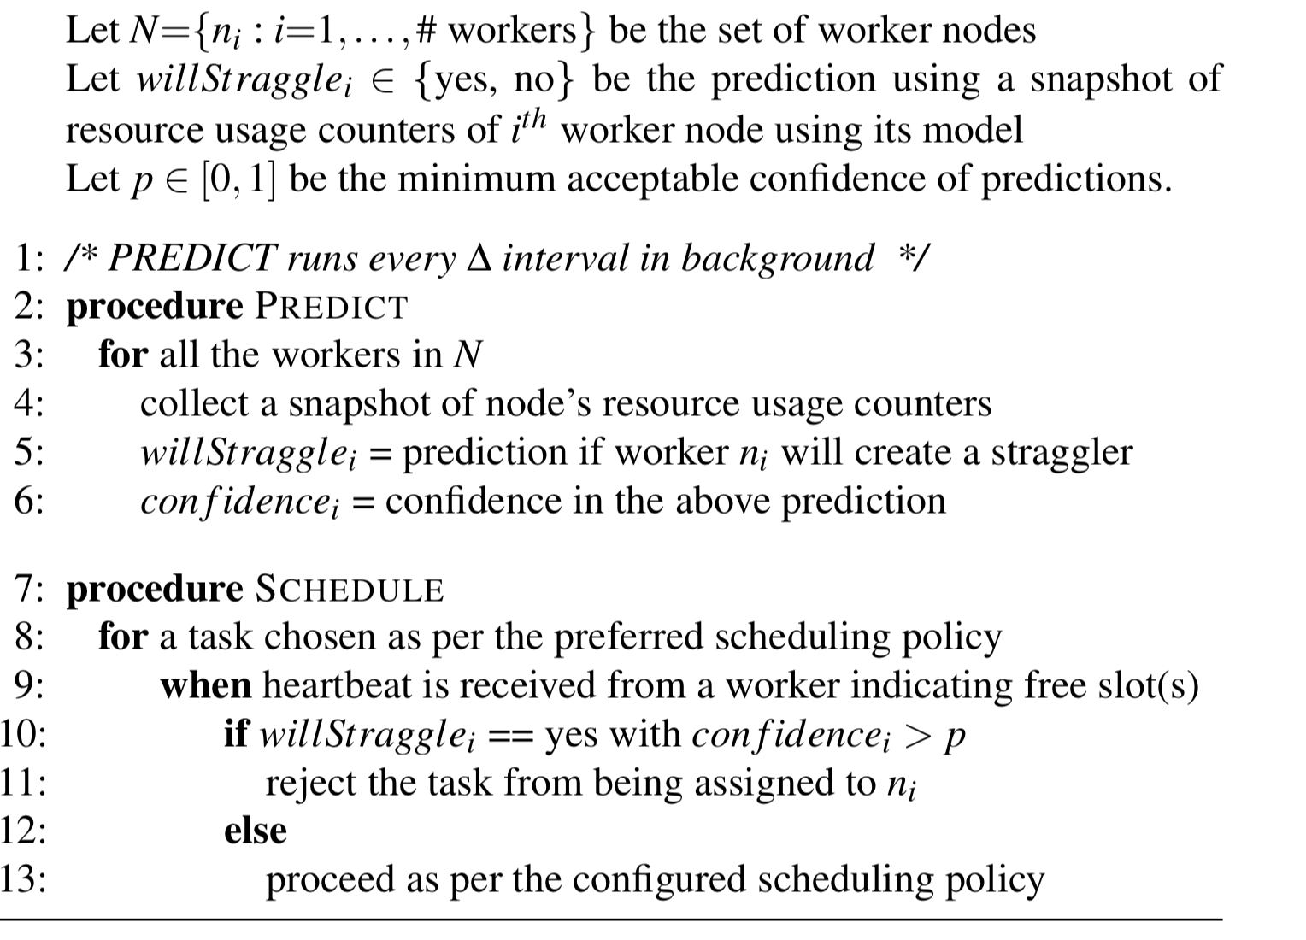
Wrangler (shortcoming)
Training time is too long

Slide 9

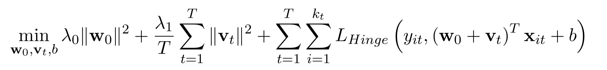
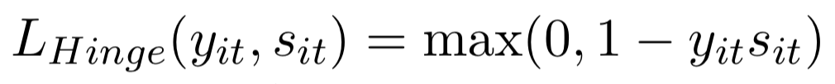
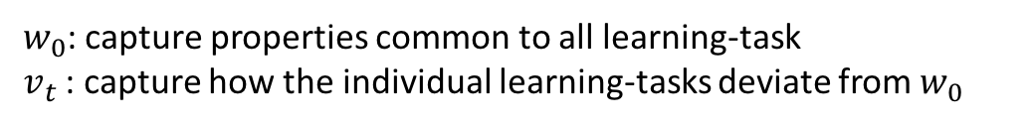
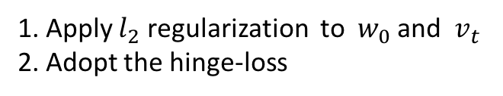
Multi-task learning for straggler avoidance
$w_{0}$: capture properties common to all learning-task
$v_{t}$ : capture how the individual learning-tasks deviate from $w_{0}$
1. Apply $l_{2}$ regularization to $w_{0}$ and $v_{t}$
2. Adopt the hinge-loss

Slide 10
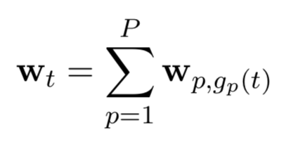
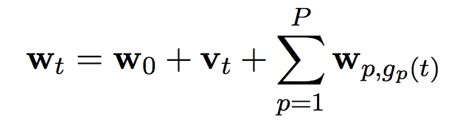
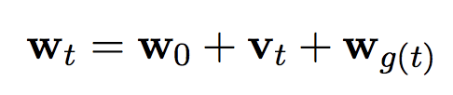
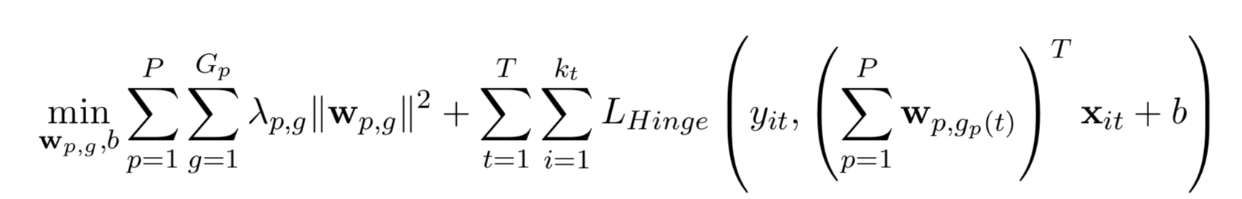

#(p,g) denotes the number of learning-tasks assigned to the g-th group of the p-th partitioning

Slide 11
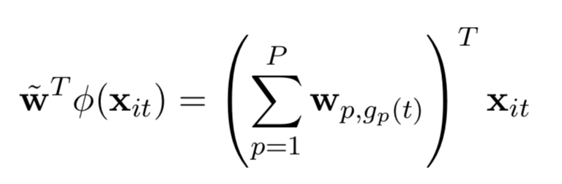
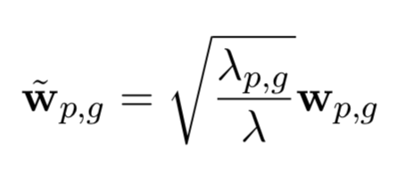
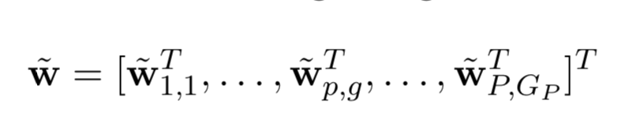
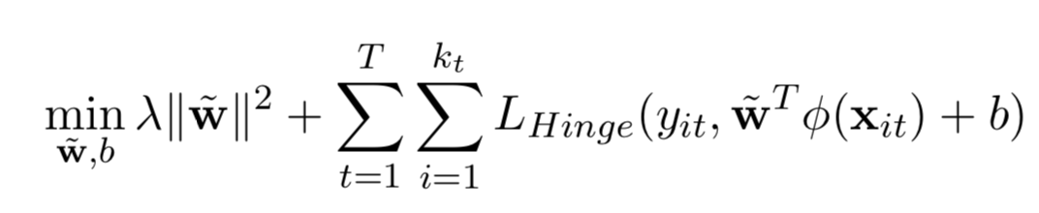
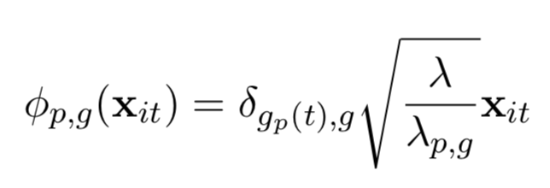
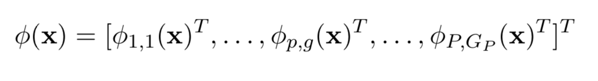
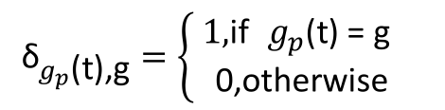
Reduction to a standard SVM
$${\text{δ}}_{g_{p}\text{(}\text{t}\text{),}\text{g}}=\left\{\begin{aligned} \text{1,}\text{if} g_{p}\text{(}\text{t}\text{) = }\text{g} \\ \text{0}\text{,}\text{otherwise} \end{aligned}\right.$$

Slide 12
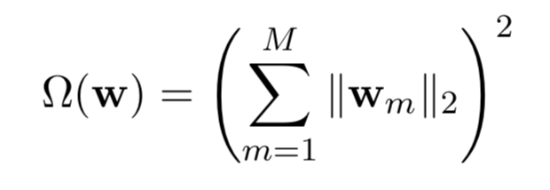
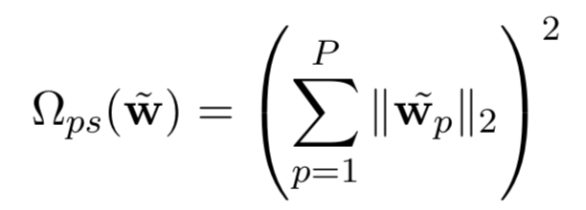
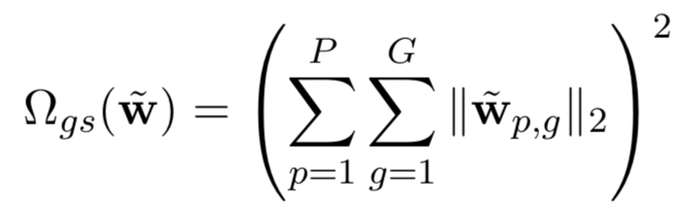
Automatically selecting groups or partitions
keep only a minimal set of groups/partitions while maintaining high classification accuracy
use mixed l1 and l2 norms to induce a sparse selection of groups or partitions
suppose we are given a long weight vector w divided into M blocks, with the m-th block denoted by wm. Then the squared mixed l1 and l2 norm is:
l1 norm will force some elements of this vector to be set to 0
force the corresponding block of weights wm to be set to 0
entire blocks of the weight vector to be set to 0
all the weight vectors corresponding to a single partition in the same block
the weight vector of each group of each partition in separate blocks

Slide 13
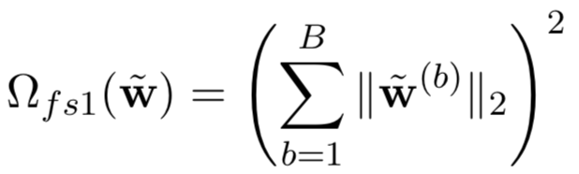
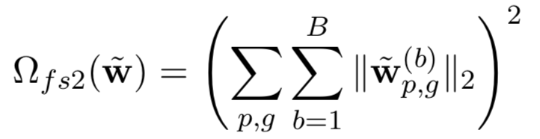
4.4 Automatically selecting features

Slide 14
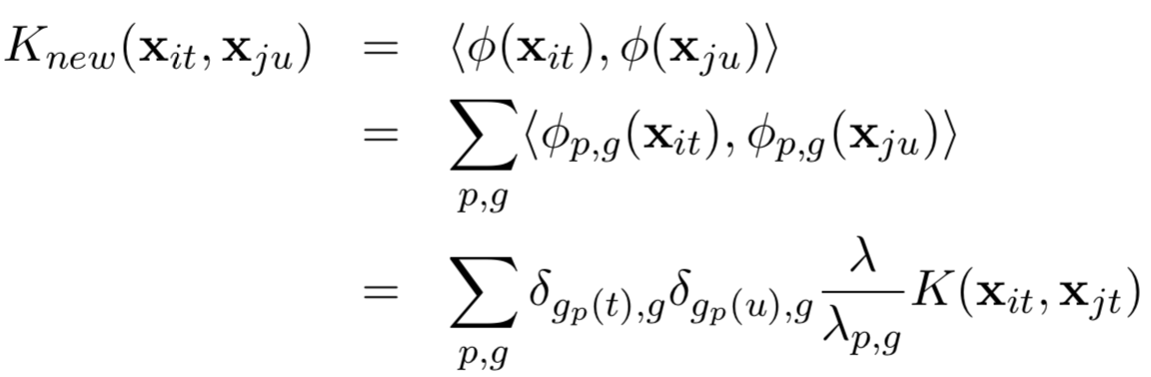
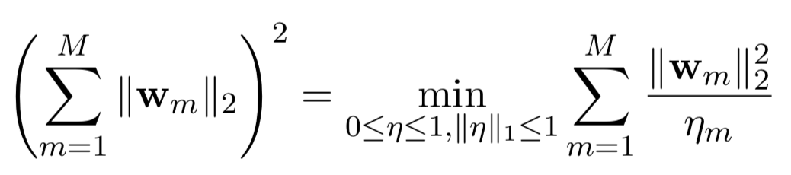
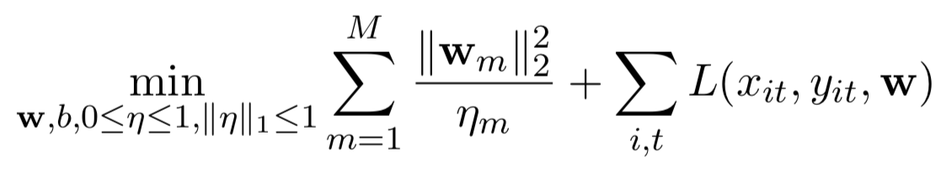
Kernelizing the formulation (Aflalo et al., 2011):

Slide 15

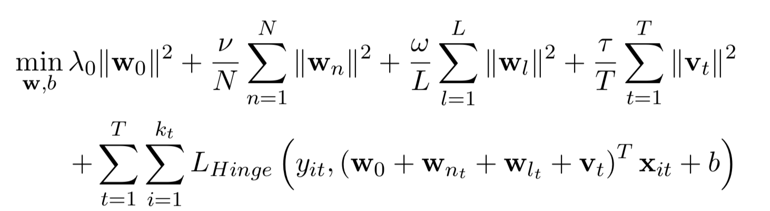
Application to straggler avoidance
λ0 = ν = ω = τ = 1

